Slide 1
Race, Ethnicity, and Immigration

Slide 2
Background Race and Ethnicity
Biology and Race
    Eighteenth-century creation of race as a category
    Roughly corresponded to the populations of the different continents (Banton 1998)
    Race not supported by biology or scientific principles
Notes:
Influence of Charles Darwin’s theory of evolution by natural selection
Created hierarchical ranking of cultural superiority
Reinforced the legitimacy of more industrially “advanced” populations (Gould 1996)
Race does not fit scientific criteria (Keita et al. 2004)
Social construction of race now acknowledged by (most) social science

Slide 3
What Are Race and Ethnicity?
Definitions
Definitions
  Race: A group of people believed to share common descent, based on perceived innate physical similarities
  Ethnicity: A group of people with a common cultural identification, based on a common language, religion, ancestral origin, or traditional practices
Notes:
Race is socially constructed and is a social definition.
Race is not strictly biological or natural.
Racial identification usually conforms to how others see us and involves self-identification.
The American definition of “Black” emerged from the economic interests of slavery, not a scientific understanding of race (Moran 2001).
The rule of hypodescent, or the “one-drop” rule, identified anyone with any amount of Black ancestry as Black in the eyes of the law and white society (Moran 2001).
Race reflects social perceptions of biological categories.
Race is a social category.
Categories and perceptions are passed from parents to children.
Family and family interaction are the first site of racial self-awareness.
Race is distinct from ethnicity.
Race reflects perceived biological differences; ethnicity reflects perceived cultural differences.
Ethnicity and race are different social categories, but the concepts often overlap.
Ethnicity can sometimes be voluntary or an option, whereas race (even though it can be self-identified) is more stable.
In American culture, race and ethnicity can be (and often are) used interchangeably.
Ethnic groups can be racialized.

Slide 4
Definition of Racial Ethnicity
Definitions
  Racial Ethnicity: An ethnic group perceived to share physical characteristics
Notes:
In racial ethnicity, an ethnic group is thought about in racial terms.
It involves conflating physical similarities with cultural identification.
Example: Using the terms African American (ethnic) and Black (racial) interchangeably
Example: Identifying a woman as Latina because she “looks Latina”
Aspects of family life reflect racial and ethnic categories.

Slide 5
Definitions of Endogamy and Exogamy
Definitions
  Endogamy: Marriage and reproduction within a distinct group
  Exogamy: Marriage and reproduction outside one's group
Notes:
Exogamy is marrying someone from outside your group.
Marriage between people from different racial and ethnic groups is on the rise.
The increasing occurrence of exogamy indicates acculturation, acceptance, and similar factors, which will be discussed at the end of the chapter.
Interracial marriage is defined later in this chapter.
Endogamy is marrying someone “like yourself.”
It is an important way of maintaining racial and ethnic divisions.
It is one of the ways in which racial and racial-ethnic boundaries persist.
Marriage is discussed further in Chapter 8.

Slide 6
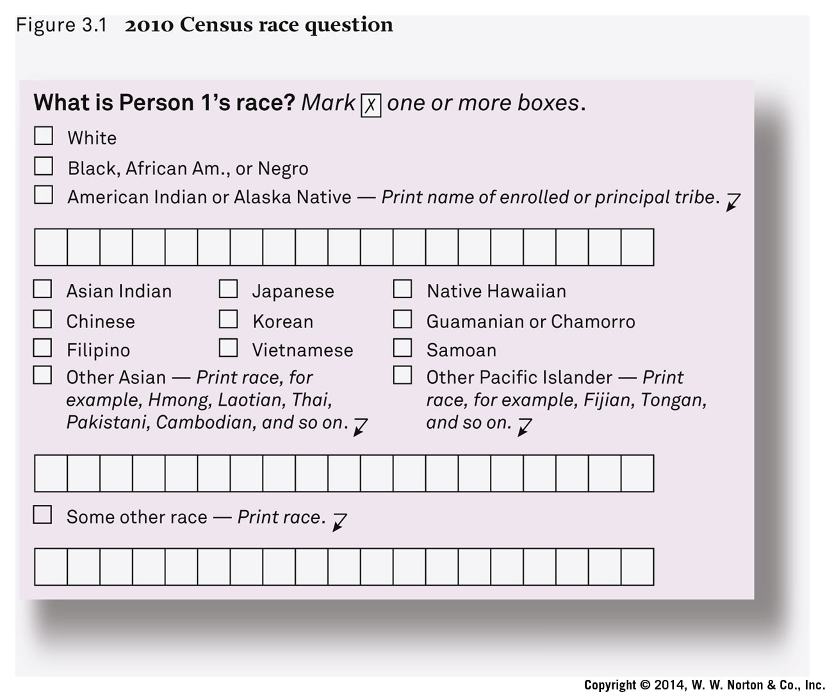
How the U.S. Government Measures Race
Notes:
The U.S. government currently counts five distinct races.
Individuals are allowed to identify with as many races as they choose.
Ethnicity (including Hispanic and Latino) is counted in a separate category.
The census is undertaken every 10 years, as mandated by the U.S. Constitution.
An analysis of the census race question can give us insight on how Americans view race.
In 2020, the Census Bureau will probably begin using a new form to clear up confusion many people have over the difference between race and ethnicity.
The Census Bureau proposes combining the races and Latino ethnicity into one question.

Slide 7
Whiteness
What about Whites?
  Whiteness is another culturally constructed category.
  Who is considered “White” has changed over history.
  Whiteness is also perceived as biological but is in fact culturally constructed.
Notes:
European ethnic groups from the nineteenth and twentieth century became what we now perceive as White Americans.
This involved a process of immigration and assimilation, which will be discussed later in this chapter.
Whiteness is often taken for granted or goes unrecognized.
Racial-ethnic groups have more difficulty identifying as White.

Slide 8
Minority Group
Minority Group: A racial or ethnic group that occupies a subordinate status in society
Notes:
Minority status does not necessarily mean a group of fewer people.
Minority refers more to a group’s relationship to the majority group
A majority group is one that has access to power, status, privilege, and resources.
The unequal power relationship between minority and majority is especially important.

Slide 9
American Stories: American Indians
American Indians
  Traditional Family Life
  On and Off the Reservations
  Many still live in very harsh conditions far from ancestral homelands.
Notes:
Population decimated by conquest, oppression, disease, and genocide
Family life has been crucial to survival and resistance.
Population beginning to grow again, especially in last 50–100 years
Self-identification has become more culturally acceptable
More willingness today to identify with (mixed) heritage than previously
Relatively high rates of mixing and intermarriage historically with Whites and Latinos
Family life was central to social structure.
It stressed values of cooperation over competition and collectivity over individualism.
Family boundaries were not strict or narrow; rather, they were broadly defined.
Diverse family practices
Included acceptance of same-sex marriage and a third gender identity
Some polygamy, but it was not a predominant practice
The majority left tribal lands in the twentieth century.
Forced relocation, boarding schools, and placement of children with White foster families disrupted social and family life.
In 2010, only 22 percent of American Indians were living on tribal land.
This weakened the hold of traditional values and practices, and of families.
Modern problems include obesity, diabetes, alcoholism, suicide, and violence (especially against women).

Slide 10
American Stories: African Americans and Slavery’s Legacy
African Americans
  Slavery’s Legacy
    The Moynihan Report—1965
      Led to assessment by Senator Daniel Patrick Moynihan in the Moynihan Report
      Daniel Patrick Moynihan, U.S. senator (NY), sociologist and government analyst
      Contributed to the belief that the nature of the Black family was fundamentally flawed
Notes:
Racial inequality experiences through family life
Issues such as slavery, discrimination, poverty, unemployment, high mortality, and segregation
Longer-term role of slavery’s legacy
Powerful presence in Black families, but also resilience
Families shaped more by slavery, discrimination, and poverty than by cultural traditions from Africa
Families more fluid, less stable
Informal, common-law marriage and higher divorce rates than for other groups
Weak tradition of nuclear family
Matriarchal, female dominated
“Problem” of female domination
Judged Black family as too female centered and matriarchal
A type of “blame the victim” approach
Created further racist stereotypes
Countered by the Family Resilience approach

Slide 11
American Stories: African Americans Continue …
African Americans
  Slavery’s Legacy
  Family Resilience
  Urban Poverty
  Retreat from Marriage?
Notes:
Economic hardship even after slavery
Kept traditional nuclear family out of the reach of most African Americans
Newer theoretical approach focusing on the Black family as resilient and adaptive rather than problematic
Matrifocal, not a “problem with matriarchy”
Family resilience in the face of discrimination, migration, poverty, mortality, and lack of opportunity
Increase in industrialization and urbanization
The Great Migration between World War I and the 1950s created changes, new opportunities, and new problems.
Migration from southern rural areas to northern urban cities
Creation of residential segregation through formal and informal practices (e.g., redlining and preferential home mortgages for White families)
Deindustrialization contributed to unemployment, urban decline, and higher residential segregation (e.g., White flight)
High-profile images of Black middle class (e.g., Cosby Show) inconsistent with reality
Marriage rates of African Americans differ from those of the rest of the U.S. population.
Significantly lower rates of marriage for African Americans
Demographic and economic pressures cause reduced availability of Black men for Black women to marry.
Higher rates of incarceration, mortality, and unemployment for Black men than for other groups

Slide 12
American Stories: Latinos
Latinos
  Culture and Diversity
  Population more than 50 million
  Largest and fastest-growing minority group
  Includes recent and older immigrants from Mexico, Puerto Rico, Cuba, and other countries
Notes:
Different groups, very different experiences
Diverse origins and history
Part of Mexico annexed by United States after Mexican-American War in 1848
Also new Mexican immigrants
Commonwealth of Puerto Rico, 1898
Cuban revolution of 1959
New waves of immigrants from Central and South America

Slide 13
American Stories: Latinos and Familism
Latinos
  Familism: A personal outlook that puts family obligations first, before individual well-being
Notes:
Familism: Cultural trait associated with Latino culture
Emphasizes family role in daily life
Strong intergenerational ties
Younger average age of families
More children per family
Extended households
Helps maintain traditional culture
Sometimes exaggerated by observers and pop culture
Can slow integration into American mainstream, but also a mechanism of support

Slide 14
American Stories: Asian Americans
Asian Americans
  Family Traditions, Modern Times
  Inequality and Diversity
Notes:
Chinese workmen in the nineteenth century were the first large Asian group
Did not have many legal rights; many did not stay
Twentieth-century waves of migration from China, the Philippines, and India
Twentieth- and twenty-first–century waves of immigration from Southeast Asia (e.g., Cambodia, Korea, Vietnam, Hmong)
Different national-origin groups with diverse populations
Common, but not universal, characteristics
Emphasis on educational excellence and higher levels of education (problematic stereotypes of “model minority myths” and “tiger moms”)
Respect and care for elders
Relatively likely to live in multigenerational households
More authoritarian parenting style
Less value on children’s independence
Lower levels of unmarried childbearing
Lower poverty rates than overall U.S. population (except for smaller groups from Southeast Asia)
Hostility and cultural division
Southeast Asian political and economic refugees
Chinese Exclusion Act of 1882
Japanese American internment during World War II
“Model minority” myths and expectations

Slide 15
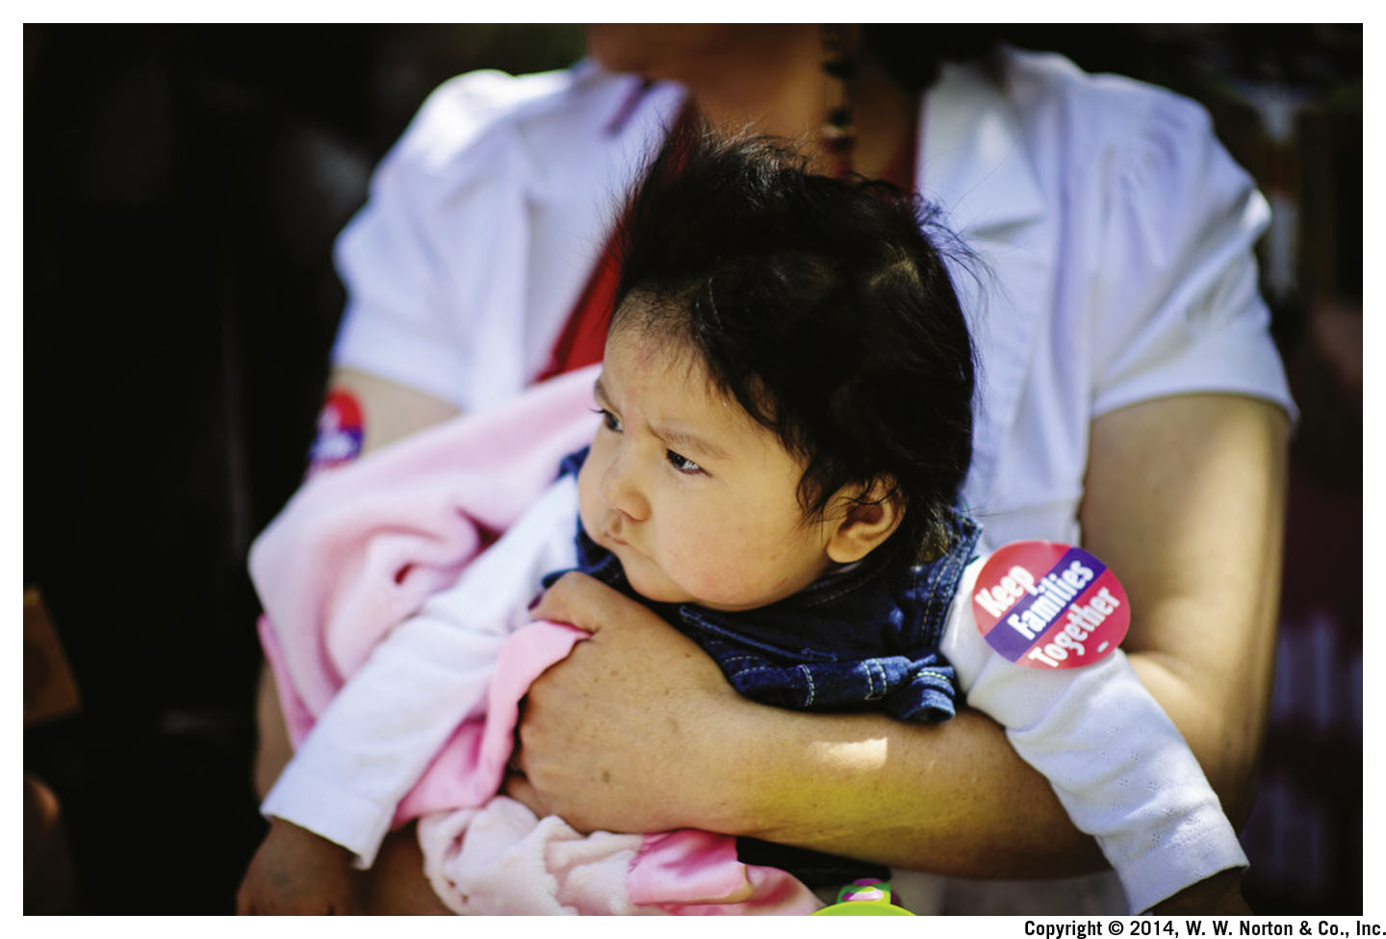
Immigration: The New Immigration
The New Immigration
Notes:
15 percent of U.S. residents born outside the United States
Currently the highest number of immigrants in U.S. history
Acceleration of immigration over the last three decades
Influenced by changes in federal laws
Creation of stronger, family-based immigration
Family reunification through immigration
Most legal migration has been family related.
This helps solidify immigrant communities but may increase social distance between immigrant groups and rest of society.

Slide 16
Immigration: Uniting and Dividing Families
Immigration Uniting and Dividing Families
  Immigration opportunities and obstacles
  Chance for new life
  Family dislocation and disruption
  Influence of changes in laws and law enforcement
  Confusing patterns of family division and unification

Slide 17
Immigration: 1882
1882: Chinese Exclusion Act
  Chinese workmen immigrated to the American West, where many worked on the new and expanding railroad.
Notes:
Anti-Chinese sentiment in the United States.
1882 Exclusion Act influenced by White-dominated labor movement
Barred Chinese from becoming citizens and blocked most new Chinese immigration until 1943
United States v. Wong Kim Ark, 1898: an important Supreme Court case
Declared that citizenship by birth was guaranteed under the Constitution
Used in current immigration debate

Slide 18
Immigration: 1924
1924: Immigration Act
  Severely restricted immigration
  End of the wave of European immigration
  Established a country-based quota system
  Eliminated immigration from Asia

Slide 19
Immigration: 1945
1945: War Brides Act
  Allowed immigration of wives and children of World War II servicemen from Europe and Asia
  Extended to Korean War brides
  Hostile reception for new immigrants

Slide 20
Immigration: 1942–1964
1942–1964: Bracero Program
  Need for agricultural workers
  Bracero means “manual laborer” in Spanish.
  Resistance to full-scale immigration
  “Temporary” work permits to Mexican workers

Slide 21
Immigration: 1965
1965: Amendments to the Immigration and Nationality Act
  Amendments to the restrictive 1952 Immigration Act
  Lifted all numerical restrictions on immigration of family members
  Ended the country-based quota system
  Impact on immigrant family members from Latin America and Asia

Slide 22
Immigration: 2002
2002: Homeland Security Act
  Department of Homeland Security took over immigration enforcement
  Made illegal crossing more difficult and dangerous.
  Unintended consequence: Immigrants are now more likely to establish permanent residence in the United States because of difficulties crossing the border

Slide 23
Immigration: 2012
2012: Deferred Action for Childhood Arrivals
  In 2012, the Obama administration implemented a rule protecting from deportation people who had entered the country illegally as children and allowing them to work.
  Because it was done without Congressional approval, any president has the authority to reverse it without approval.

Slide 24
Immigration: Generations
Generations
Notes:
Researchers refer to immigrants according to the generation of the family’s migration (e.g., first generation = immigrants; second generation = immigrants’ children)
Generational change
Each successive generation has a different experience and self-identity.
Generational conflicts (including acceptance of intermarriage) can occur when one generation changes more quickly than the other.
However, recent research suggests that the age of immigration, not just the generation of immigration, influences the acculturation experience with the new culture.

Slide 25
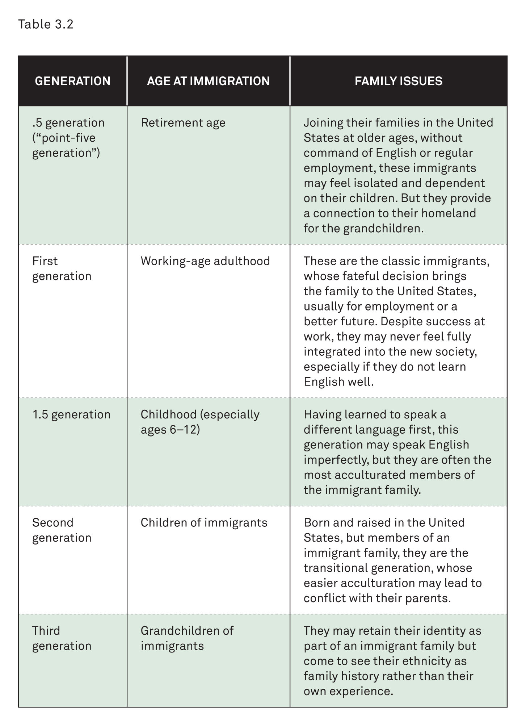
Immigrant Generations
Notes:
.5 generation: older retirement age; connection to homeland but may feel isolated and dependent on children
First generation: classic immigrants; usually immigrated for employment; may never feel fully integrated
1.5 generation: immigrate as children; learn language and are more integrated than older immigrants
Second generation: children of immigrants; born and raised in United States; transitional generation
Third generation: grandchildren of immigrants; may retain immigrant family identity as a part of family history

Slide 26
Immigration: Acculturation
Acculturation: The acquisition of a new culture and language
  Learning ways of the new homeland through acculturation process
        Consonant Acculturation
        Dissonant Acculturation
Notes:
In the United States, new groups have received very different levels of acceptance, depending on the timing of their arrival, the economic and social roles they play, and the attitudes of the dominant group toward them.
Each of these circumstances leads to a very different experience of acculturation and assimilation.
The process may be consonant (i.e., parents and children transition together).
The process may be dissonant (i.e., the children integrate more quickly and easily than the parents).

Slide 27
Immigration: Assimilation
  Assimilation: The gradual reduction of ethnic distinction between immigrants and the mainstream society
Notes:
The gradual reduction of ethnic distinction between immigrants and mainstream society
The immigrant group and mainstream society adapt to one another.
Sometimes can include the elimination of ethnic distinctions between the groups (but not always and not completely)
Different from acculturation because assimilation is only successful with acceptance of ethnic group by the dominant group

Slide 28
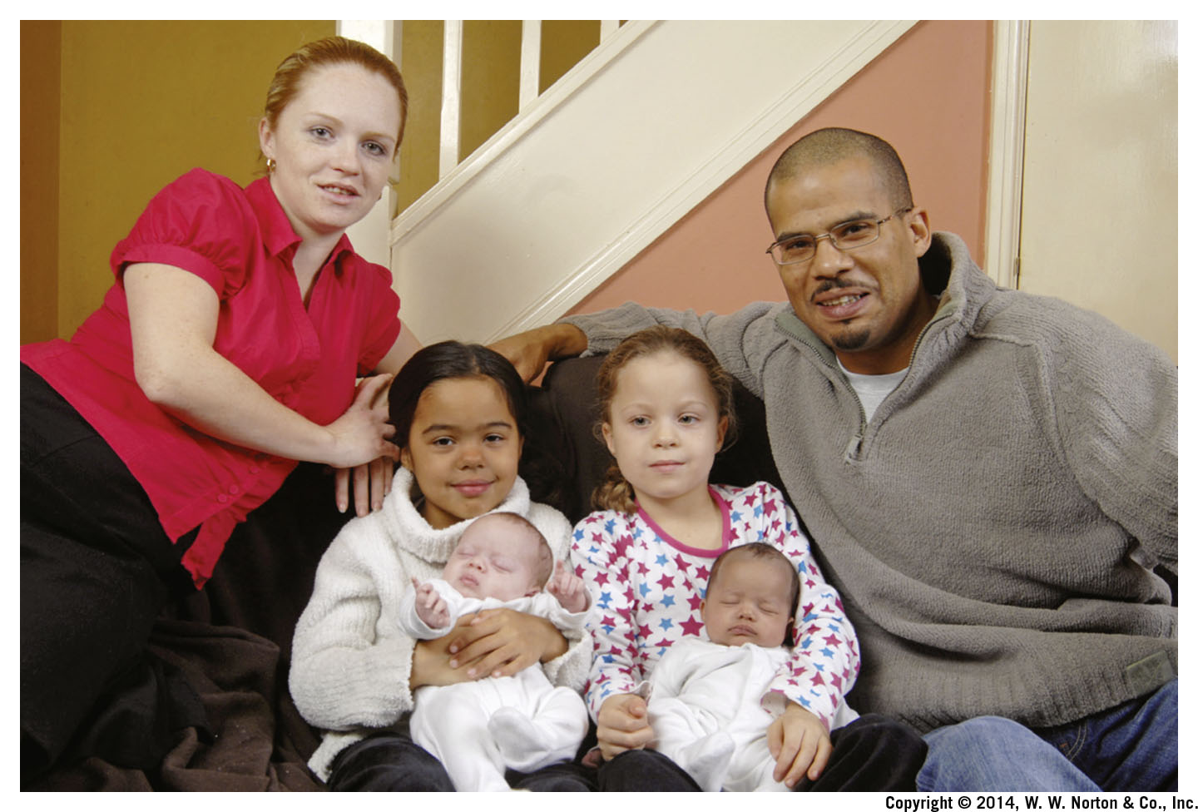
Intermarriage
Notes:
When people from different racial or ethnic groups marry, the groups become integrated.
Intermarriage between racial and/or ethnic groups is discussed further in Chapter 8.

Slide 29
Intermarriage: Definition
Intermarriage: Marriage between members of different racial or ethnic groups
Notes:
Intermarriage allows for more interaction of extended families.
It can be an indication of integration between groups.
It can be used to observe the acceptance of integration and difference.
It allows for some measurement of social acceptance.

Slide 30
Intermarriage: Social Distance
The Future of Social Distance
  Social Distance: The level of acceptance that members of one group have toward members of another group
Notes:
Intermarriage can be used as a measure of social distance.
Intermarriage contributes to integration.
When people from different racial or ethnic groups marry, their extended families interact.
Measuring the frequency of intermarriage allows for some measurement of integration.
We can observe the acceptance of difference and changing attitudes toward social distance.

